Slide 1
North Carolina Arts Council Artist Support Grant Application Workshop
Wednesday, August 26, 2020 10am
Region 17 –
Buncombe, Haywood, Henderson, Polk, Rutherford and Transylvania Counties

Slide 2
North Carolina Arts Council Artist Support Grant
The Artist Support Grant provides direct support to individual artists for professional and artistic development, either to enhance their skills and abilities to create work, or to improve their business operations and capacity to bring the work to audiences.
The fund was created as part of North Carolina Arts Council’s reprioritization of grants to provide stabilization for artists and organizations since the onset of COVID-19.

Slide 3
Eligibility for Application
The Artist Support Grant is intended to support a broad range of talented visual, performing, literary, and interdisciplinary artists.
Eligible candidates may be either emerging or established artists. Applicants should demonstrate a commitment to spending a significant portion of their time on their work as artists.

Slide 4
Eligibility for Application
Individuals and Artist Collectives - Both individual artists and small, unincorporated groups of collaborating artists are eligible to apply.
Residency – Artists should have lived in the region where they are applying continuously for at least one year prior to the consortium’s application deadline. An applicant must be at least 18 years old and either a U.S. citizen or a permanent resident alien. Proof of residence and status may be required by the consortium. Artists who live in more than one region should apply only where they spend the majority of the year.
All members of a collaborating team must be North Carolina residents, live in the region where they are applying, and meet the other eligibility requirements. Résumés documenting residence from all team members should be included with the application.

Slide 5
Eligibility for Application
Multiple Awards – Artists who are sole proprietors of organizations that have already received funding for FY20-21 from the N.C. Arts Council are ineligible to apply.
Conflict-of-Interest - Current board and staff members of the participating partner organizations and their family members are not eligible to apply for the award.

Slide 6
Evaluation Criteria
Artistic Merit
Demonstrated talent in an art form and overall excellence of the artist’s work
Clear commitment to a career as a practicing professional artist

Slide 7
Evaluation Criteria
Project Merit
Benefit of the proposed project to the artist’s professional growth
Feasibility of the proposed project

Slide 8
What the Grant will Fund
Completion/Presentation of a New Work – Cost of resources necessary to complete or present a significant new work
e.g., purchasing art supplies, equipment, or space rental.
Career Promotion – Projects aimed at advertising artists’ work and/or demonstrating their skill level
e.g., websites, portfolios, audio-visual documentation, and online presentation.

Slide 9
What the Grant will Fund
Training – Costs to attend a class or workshop (in-person or virtual) aimed at either enhancing the artists’ skill level or professional development
e.g., a master class or workshop taught by acknowledged authorities in their medium.
Travel – Costs of transportation, lodging, and food for training, professional conferences, or research as allowed or possible with adhering to social distancing guidelines.
Up to 50% of grant amount may be used towards artist fees!

Slide 10
What the Grant will Not Fund
Scholarships for undergraduate- or graduate-level education
Projects that support or oppose a particular candidate for public office
Projects that are exclusive to members of a particular religious faith group
Non-profit initiatives
Projects that do not have a direct effect on the applicant’s growth as an artist
e.g. the promotion of other artists’ work

Slide 11
The Application

Slide 12
Narrative
Your Project Narrative should explain your proposed project and how it will have an impact on your career as an artist. Include your artist statement and project description:
Describe your project and the proposed use of funds.
Explain what this project will enable you to do that you are unable to do now.
Summarize how this project will advance your career or development as an artist.

Slide 13
Narrative
Your proposal needs to be:
Feasible
Don’t propose a project that seems beyond your capacity either in terms of cost, access, or other factors.
A logical step for you
It should make sense why the workshop tuition, computer, brochure, or new studio you want would be relevant and helpful to you at this point in your career.
The more specific you can be the better.

Slide 14
Narrative
General Rules of Thumb:
Use simple, declarative sentences, active voice—and get to the point. Observe the space or page limits.
Say what you need to say as efficiently as possible.
Who, what, when, where, why, and how.
If you find, after you’ve answered the application queries, that you haven’t addressed one or more of the questions, you might want to revisit your responses.

Slide 15
Narrative
General Rules of Thumb:
The narrative is not an artist statement.
Keep your answers focused on the practical needs and outcomes of your project.
Ask someone unconnected to the arts to read your application. Their perspective can be valuable in identifying aspects that are unclear or unpersuasive.

Slide 16
Budget

Slide 17
Budget

Slide 18
Budget
Provide detail.
More detail is better. You can see the difference in the detailed budget on the right:
Example 1 Example 2
Travel: $600 Mileage (200 mi. @ .535): $107
Lodging (4 nights @ $85): 340
Meals (5 days @ $35): 175
Total: $622

Slide 19
Budget
Provide supporting documentation
Getting an estimate from the provider(s) to support the numbers will result in a stronger application.
For most equipment, airfares, and materials costs, prices can be found online. For professional services, you may need to request an estimate.
Always provide documentation for class, workshop, or conference registration costs.
If studying with a specific teacher is part of your proposal, say why and provide documentation of the teacher’s credibility.

Slide 20
Budget
You are not required to spend your own money!
If applicable, show other sources of income.
If you are pursuing or have secured donations from others, especially for more ambitious projects, include that information, as well.
Just leave enough room on the expected income side of your budget to make it clear that you do need the grant.

Slide 21
Résumés or Bios
As a rule, they should be:
Artist résumés
They should focus on your activities as an artist, including exhibitions, performances, readings, screenings, commissions, collections that have acquired your work, publishing history, residencies, articles and reviews of your work, workshops taught or taken, lectures, panels, education, employment, awards, etc.
Abbreviated
A suggested length is two-to-four pages.

Slide 22
Résumés or Bios
If you have limited experience as an artist, foreground your existing artistic achievements in your resume and condense your other work and experience into broad background information.
Use this situation to make the case that the grant is especially important towards taking a meaningful step forward in your artistic career.

Slide 23
Work Samples
Strong, high-quality work samples are essential for a successful application.
The first stage in every process is an artistic evaluation, so pay attention to what you choose to submit.

Slide 24
Work Samples
Selection
Be selective about what you include. Choose samples that you consider to be:
Strong and recent representations of the quality of your work.
Cohesive and relevant to the project you have proposed.

Slide 25
Work Samples
Work-sample descriptions and labeling
An inventory list should accompany the work samples provided.
The basic information is specific to each discipline. This will be explained in further detail on the next slides.

Slide 26
Work Samples
Dance and Performing Arts
Documentation of up to three recorded performances. Videos uploaded may not exceed a total time of ten minutes.
Description: include date and location of performance, title of piece, names and roles of key people, including directors, choreographers, lead performers/actors, etc. A short summary may also be included.

Slide 27
Work Samples
Music
Documentation of up to three recorded performances. Audio or video uploaded may not exceed a total time of ten minutes.
Description: include date and location of performance, title of piece, names and roles of key people, including directors, choreographers, lead performers/actors, etc. A short summary may also be included.
Composers and songwriters should also submit scores, lyrics, and/or lead sheets, as appropriate.

Slide 28
Work Samples
Writing
Fiction, creative nonfiction, and playwrights may submit no more than 12 pages each of one to two manuscripts.
Poets may submit five to seven poems.
Playwrights may also submit documentation of a recorded performance or staged reading of their plays (videos, clip not to exceed five minutes.)

Slide 29
Work Samples
Visual Art and Craft
Up to 15 images of your work.
Images must be high quality – not blurry or pixelated.
Description: title, date of completion, medium, and dimensions.

Slide 30
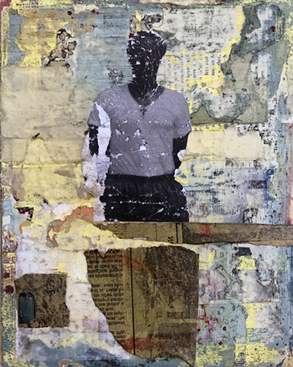
Work Samples
Good Examples:
No keystoning
Clear, high quality
Image is of work only
Simple background
Image courtesy of Liz Kelly Pottery
There Will Be No Miracles Here by Antoine Williams

Slide 31
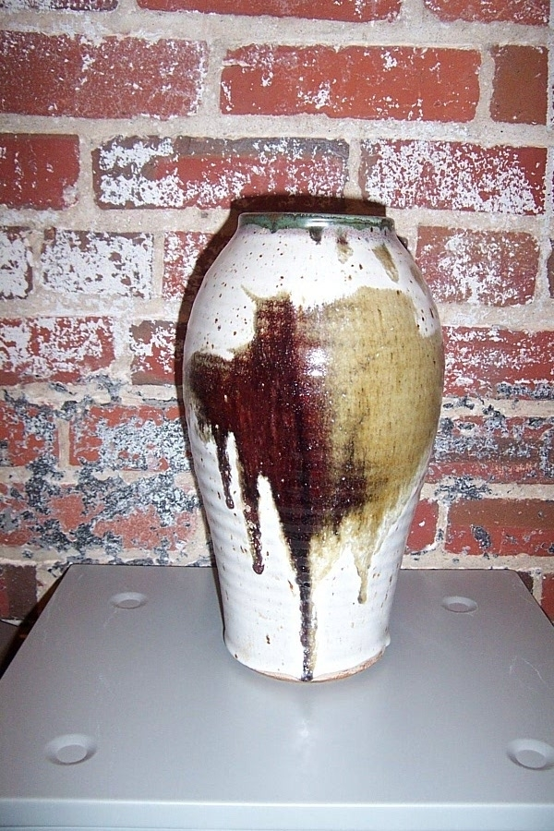
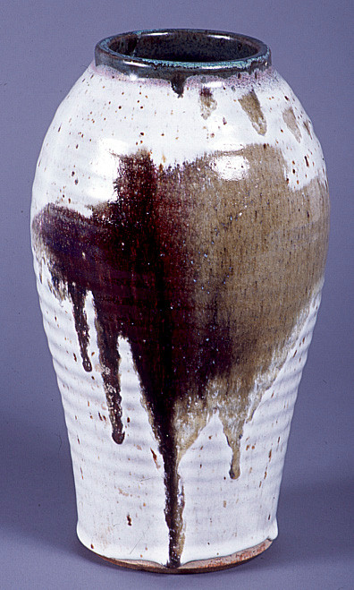
Work Samples
Three-Dimensional
No:
Yes:
Images courtesy Pitt County Arts Council

Slide 32
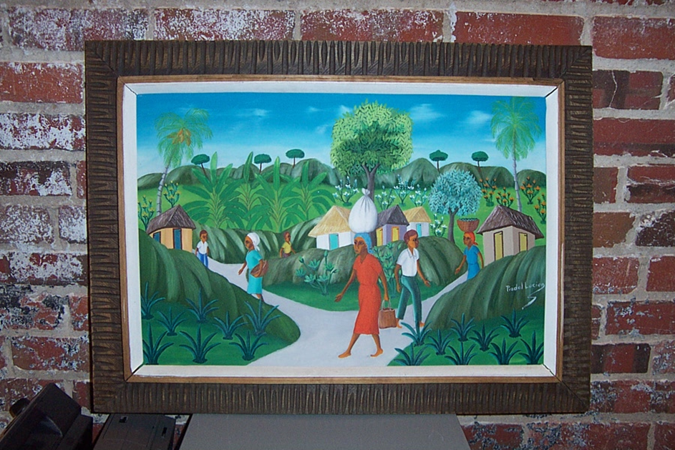
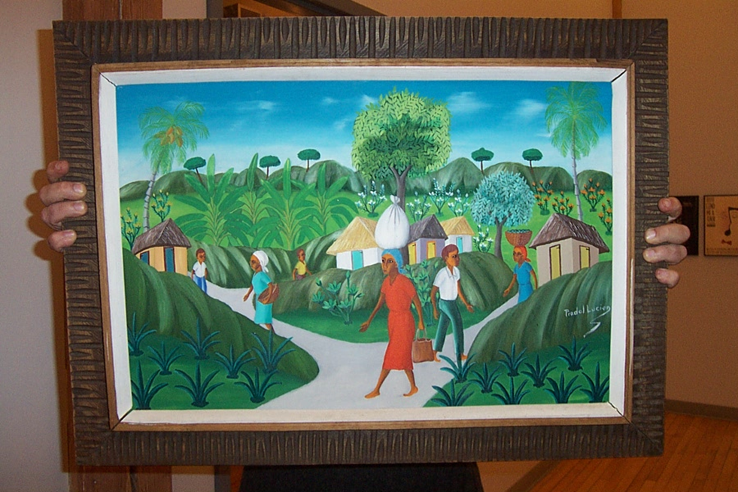
Work Samples
Two-Dimensional
No:
Images courtesy Pitt County Arts Council

Slide 33
Work Samples
Two-Dimensional
Yes:
Image courtesy Pitt County Arts Council

Slide 34
Work Samples
Film
Documentation of one or more completed films.
Video clips not to exceed five minutes.
Description: include date and location of performance, title of piece, names and roles of key people, including directors, choreographers, lead performers/actors, etc. A short summary may also be included.

Slide 35
Work Samples
For video and audio work samples:
Note that due to file sizes, YouTube and Vimeo links are preferred for video.
Please indicate if the work sample is professionally mastered. Do not upload MP4 files directly to the application.

Slide 36
Work Samples
Samples must be of your work only!
Work must be completed within the past three years.

Slide 37
Letters of Recommendation
Letters of recommendation are sometimes required, sometimes optional , but they should always be the least important part of your proposal.
Have qualified references who can speak specifically and enthusiastically about your abilities as an artist.
Consider the following as you choose your references:
First-hand knowledge of your work as an artist
Professional credentials (this is not a personal recommendation)
How recent is the reference’s encounter with your work?

Slide 38
Application Checklist
Application Profile
Narrative
Artist Statement – Attach an artist statement that describes your work and the key ideas and goals that drive you to create. (one typed page)
Artist Résumé – Attach an artist résumé that includes education, employment, public presentations of your work, publications, commissions, honors, grant/fellowship awards, and relevant experience. (four pages maximum)

Slide 39
Application Checklist
Budget Support – Provide support information for your budget, i.e. cost of materials, price quote on services, etc.
Support Materials – You may submit reviews, programs, catalogs, and other support materials relevant to the project.
Work Samples and Inventory List
Application Deadline: September 30, 2020

Slide 40
If you receive a grant…
You will enter into a contractual agreement with the Haywood County Arts Council.
Any promotional and marketing materials for the proposed project must demonstrate use of N.C. Arts Council logo and credit line.
Projects must be completed before June 30, 2021.

Slide 41
Questions?
If you need help with your application, or have specific questions, contact:
Primary Contact:
Leigh Forrester
Haywood County Arts Council
Phone: (828) 452-0593
E-mail: director@haywoodarts.org
Web: http://www.haywoodarts.org/

